Slide 1
User Experience Design
TA: Aaryan!

Slide 2
Learning Objectives
By the end of this lecture, students will be able to:
Understand design psychology and principles
Use necessary tools to conduct comprehensive user-research
Communicate their thoughts and ideas about user-experience design

Slide 3
Outline
Design Psychology
User Research Methods
Business Model Canvas
User Personas

Slide 4
Design Psychology
What does it consist of?
It is understanding how people think, respond to design elements, and their cognitive abilities and limitations.
Why would we want to know this?
What are some things you considered when you were storyboarding - any particular groups of people?

Slide 5
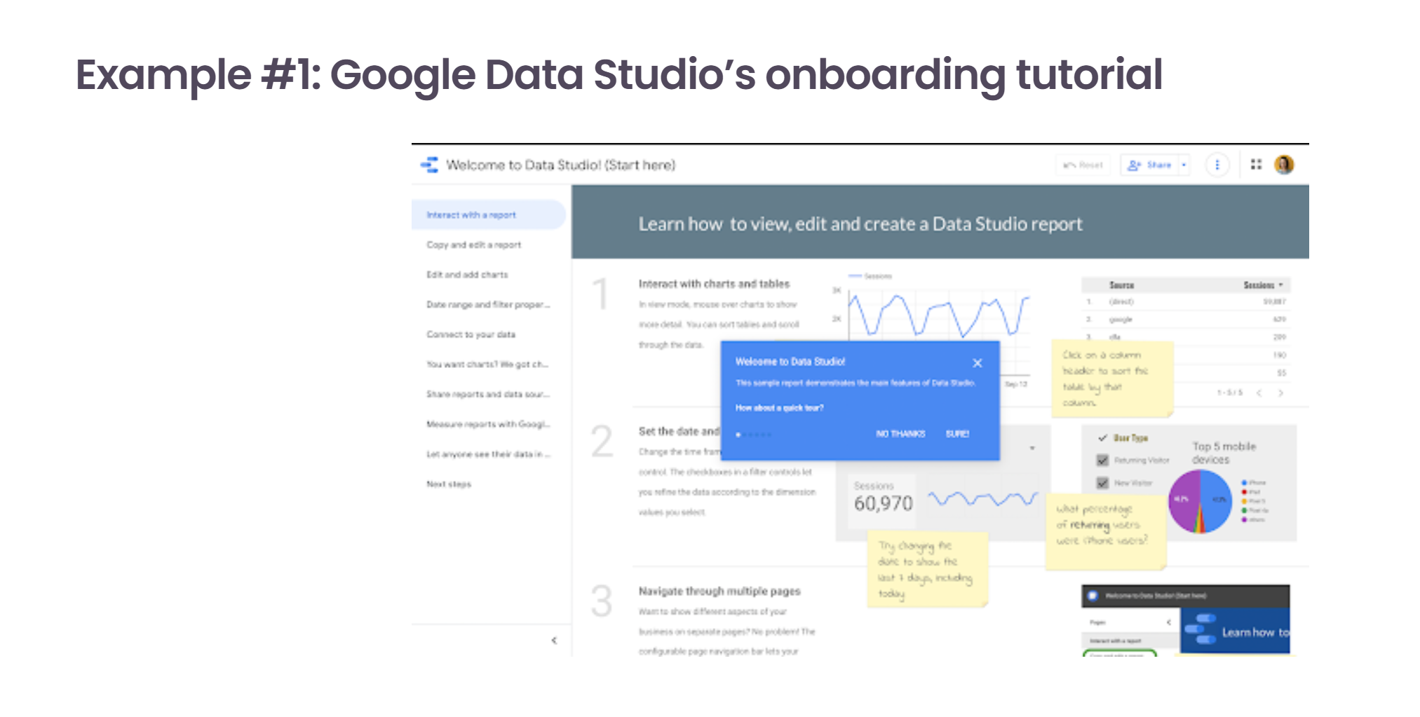
What to avoid?
What makes a UX bad?

Slide 6
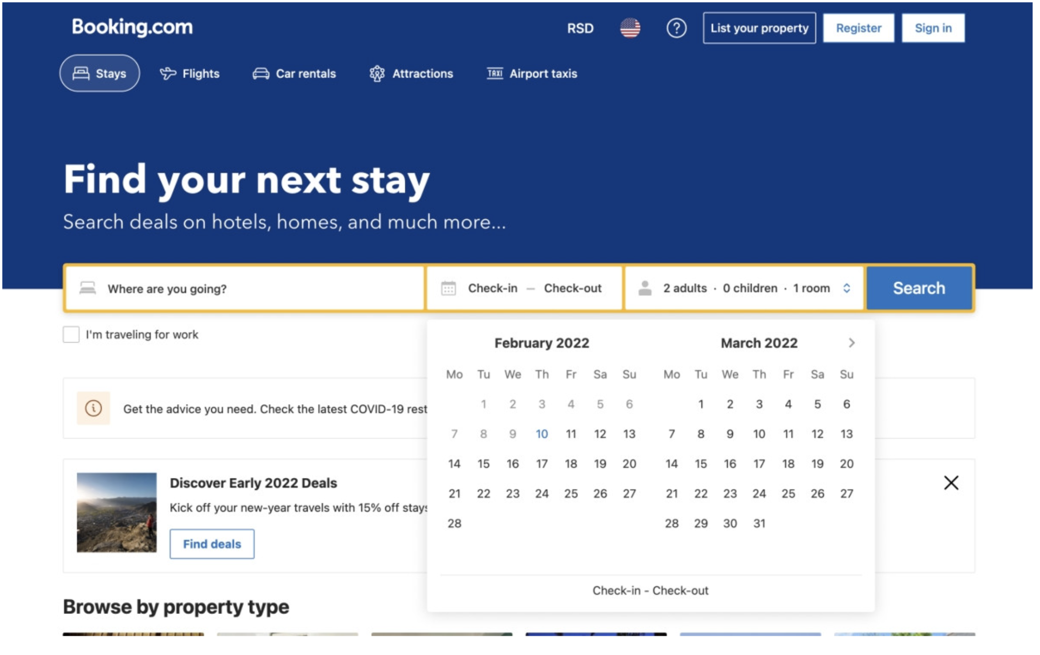
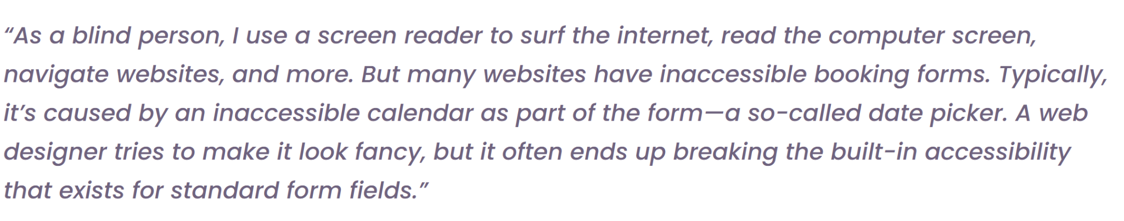

Slide 7
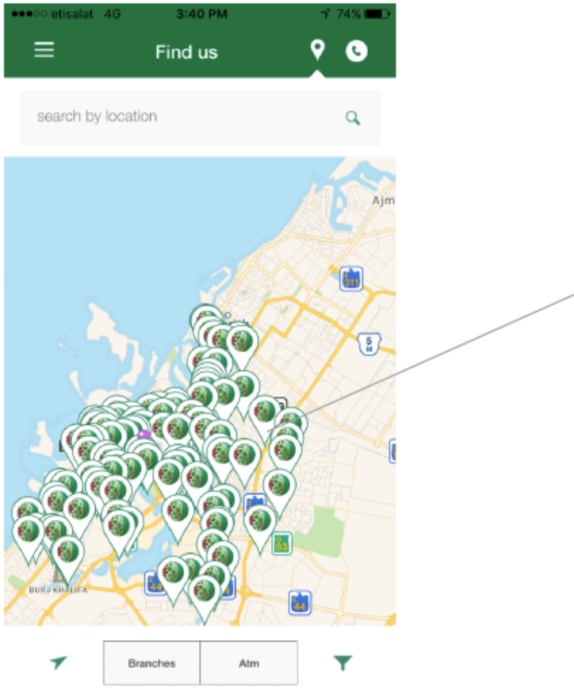
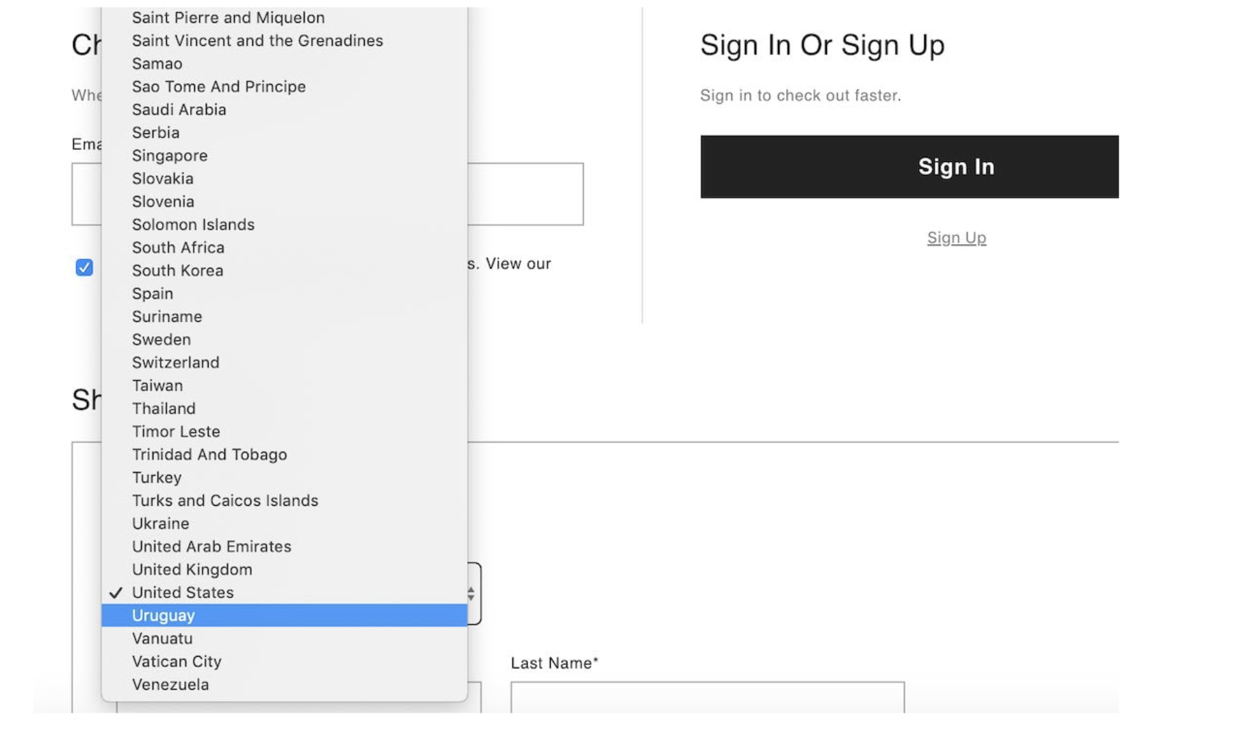

Slide 8
User Research Methods
There are two ways of conducting user-research:
Involving the user - User Interviews
Without the user - Card Sorting, Personas, Roleplay, Rapid Prototyping/Brainstorming

Slide 9
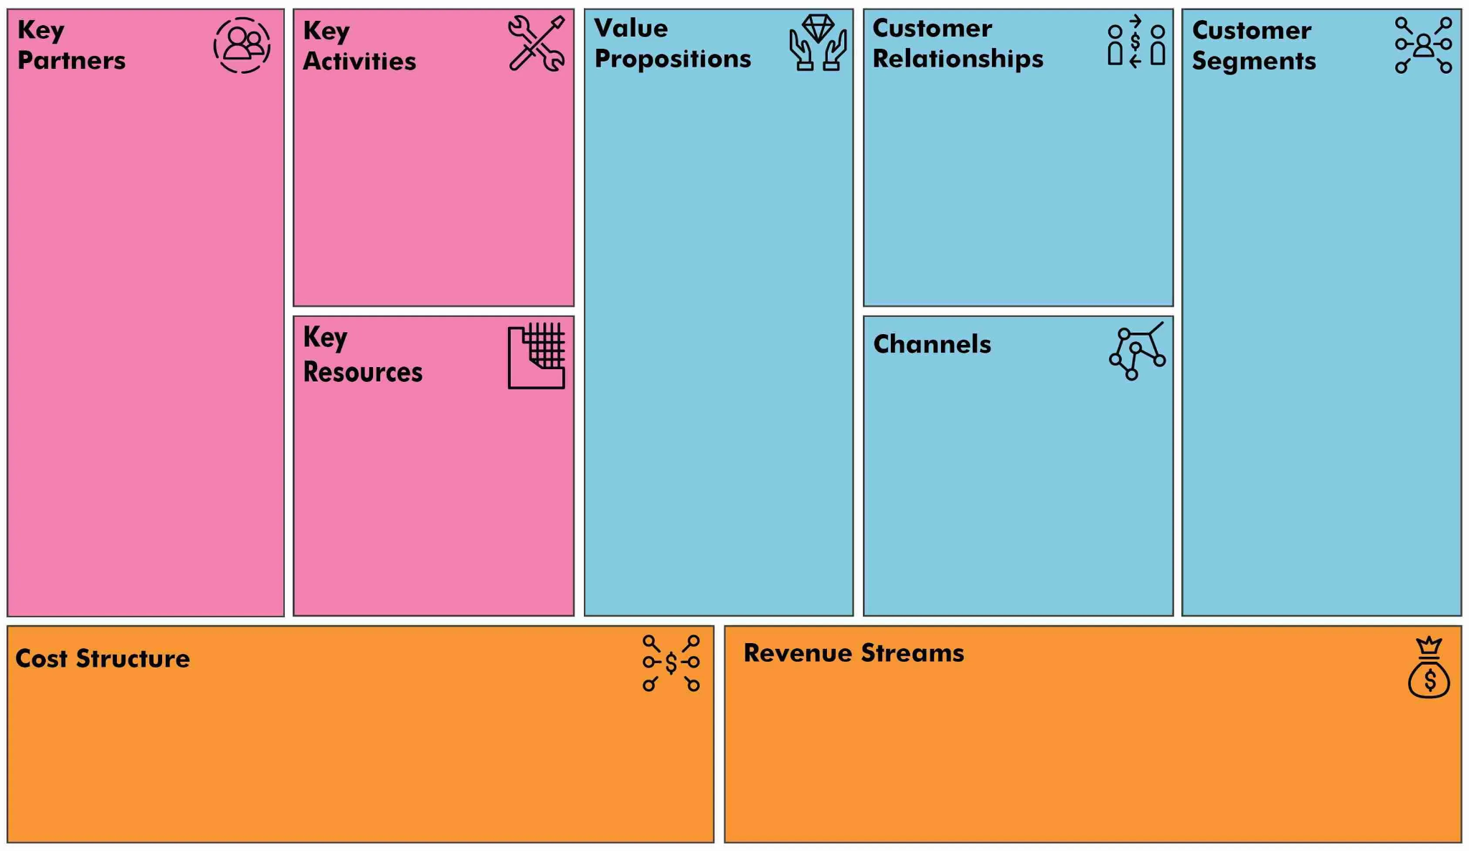
Business Model Canvas
Notes:
https://www.chameleon.io/blog/bad-ux-examples

Slide 10
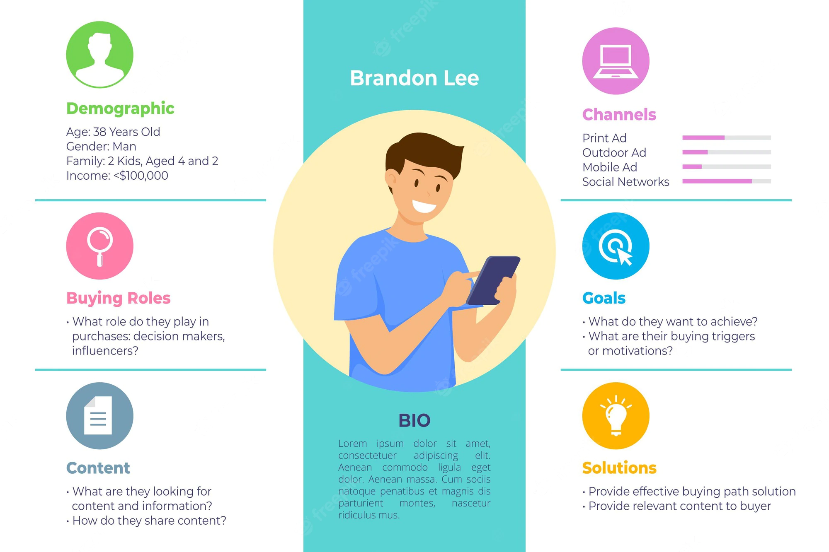
User Persona Template

Slide 11
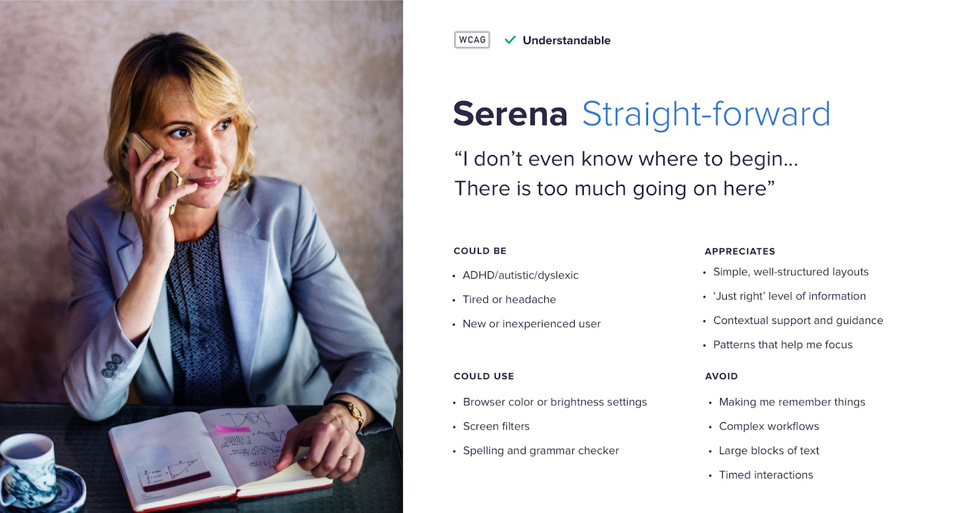
Examples of User Personas
https://uxdesign.cc/bringing-inclusive-design-to-life-through-personas-83ba26a41109

Slide 12
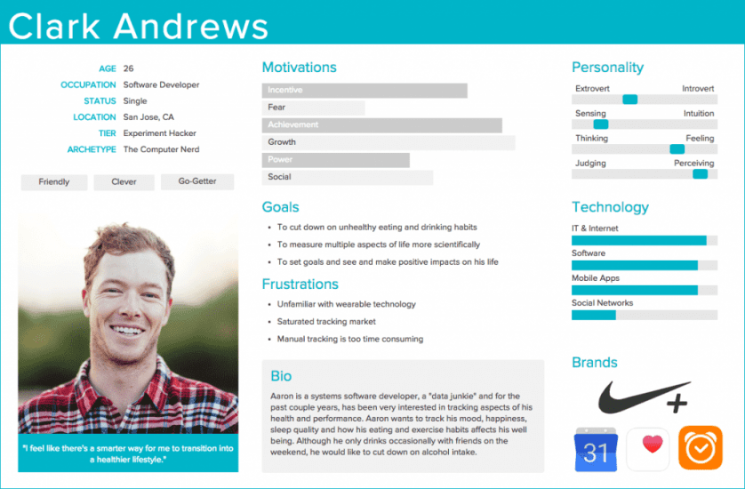
https://xd.adobe.com/ideas/process/user-research/putting-personas-to-work-in-ux-design/

Slide 13

Card sorting
Structured and participatory exercise
Schedule
Updates
History
Travel Information
Destinations
Map
Hotels

Slide 14
Card sorting
About
Book a Trip
My Account
History
Updates
Schedule
Travel Information
Destinations
Map
Hotels

